Slide 1
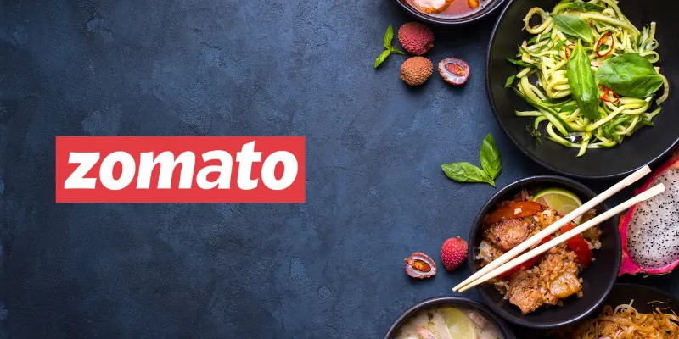
RESTAURANTS EXPANSION
Expansion Strategies and Marketing Insights
Katepalli Deva Naga Sai Kumar

Slide 2
Presentation Overview
Problem Statement
Overview of the Data
Performance Insights
Dashboard at a Glance
Top Insights
Recommendations

Slide 3

Problem Statement
You are hired as a consultant data analyst by Zomato where the team is looking for expansion and opening more restaurants. Your task is to develop strategies/suggestions for opening newer restaurants.

Slide 4

Overview Of The Data
9,000+ restaurants across 15 countries.
1,825 unique cuisines.
Avg. rating = 2.9.
Avg. price range = 1.8.
Total voters = ~1.5M.

Slide 5

Performance Insights

Slide 6
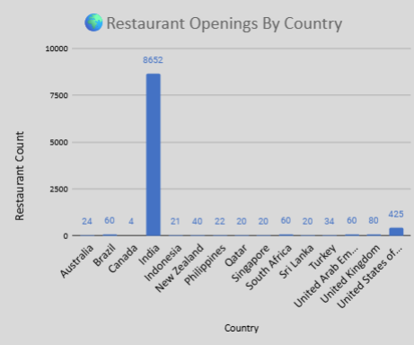
Global Restaurant Footprint By Country
India = 90% restaurants (8,652 of 9,551) → strong domestic footprint.
Brazil, South Africa, UAE, UK, USA = moderate presence (60–434) → scalable.
Qatar, Singapore, Sri Lanka, Canada = very low (4–20) → untapped markets.

Slide 7
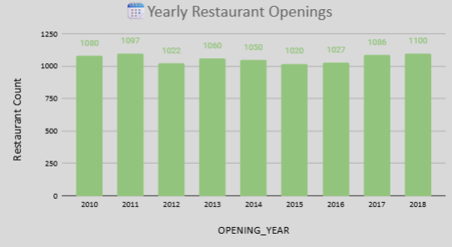
Restaurant Growth Trend (2010–2018)
Steady ~1,050 new restaurants/year.
Peaks: 2011 (1,098), 2018 (1,102).
Consistent growth → sustained demand.

Slide 8
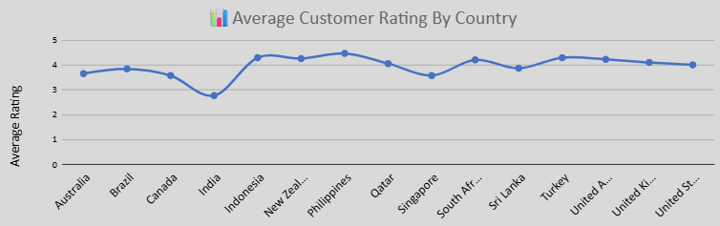
Average Restaurant Ratings By Country
High performers: Philippines, Indonesia, New Zealand (>3.8).
Balanced: USA, UK, UAE → moderate presence + good ratings.
Weak spot: India lowest (2.77) despite largest market.

Slide 9
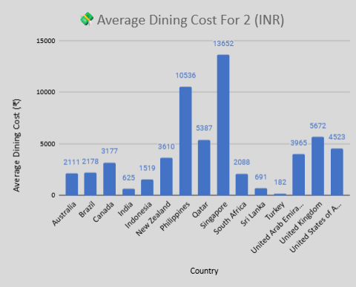
Country-wise Dining Cost Comparison (In INR)
High-cost: Singapore (13,295 INR), Philippines (10,370 INR).
Mid-range: UK, USA, UAE, NZ (3,600–5,500 INR).
Affordable: India, Sri Lanka, Turkey, Indonesia (<1,500 INR).

Slide 10
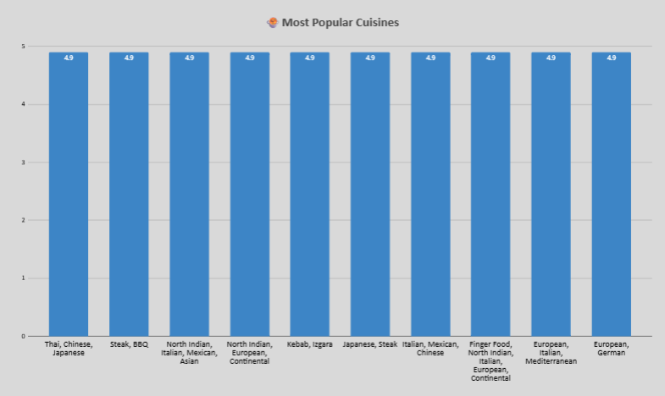
Top 10 Winning Cuisines

Slide 11
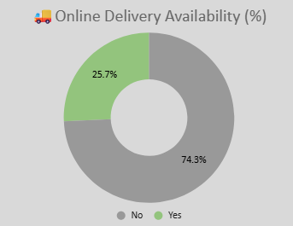
Online Delivery Adoption
74% (7,100) → No online delivery.
26% (2,451) → Online delivery available.
Gap = opportunity for digital adoption

Slide 12
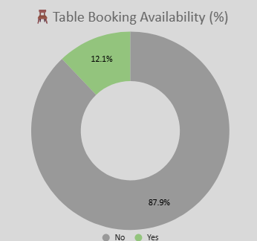
Table Booking Availability
88% (8,393) → No table booking.
12% (1,158) → Table booking available.
Untapped area for convenience & planning.

Slide 13
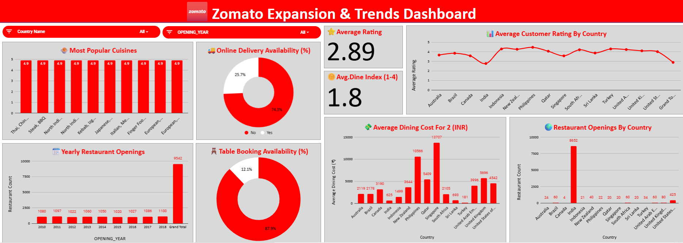
Dashboard At A Glance

Slide 14

Top Insights
Best Markets: Qatar, Indonesia, New Zealand, Sri Lanka.
Why: High ratings + low competition + favorable dining cost.
Opportunity: Balance of premium and budget-friendly models.

Slide 15

Top Recommendations
Expansion Markets: Qatar, Indonesia, New Zealand, Sri Lanka.
Cuisines: Indo-Chinese (Qatar), Seafood (Sri Lanka), Dessert cafés (NZ), Modern cafés (Indonesia).
Digital Features: Online delivery + Table booking from day 1.
Pricing: Affordable in budget markets; premium branding in developed markets.
Focus: Quality, service & ambiance > pricing.

Slide 16


